Slide 1
BZML A20
Gerd Graßhoff, Mohammad Yeghaneh

Slide 2
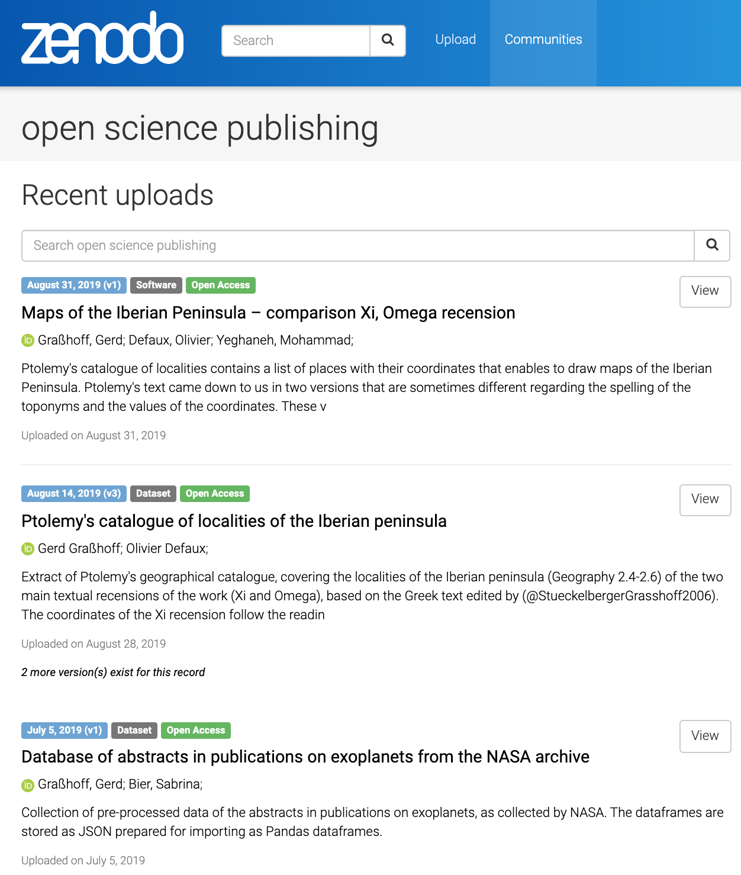
Philosophical content modeling
Kepler‘s Astronomia Nova
Latin original and engl Translation (Donahue)
Complete Transcription and text wrangling in pandas dataframe
NASA abstracts of about 30 000 scientific published articles on the astronomy of exoplanets.
Complete curated and published data set

Slide 3
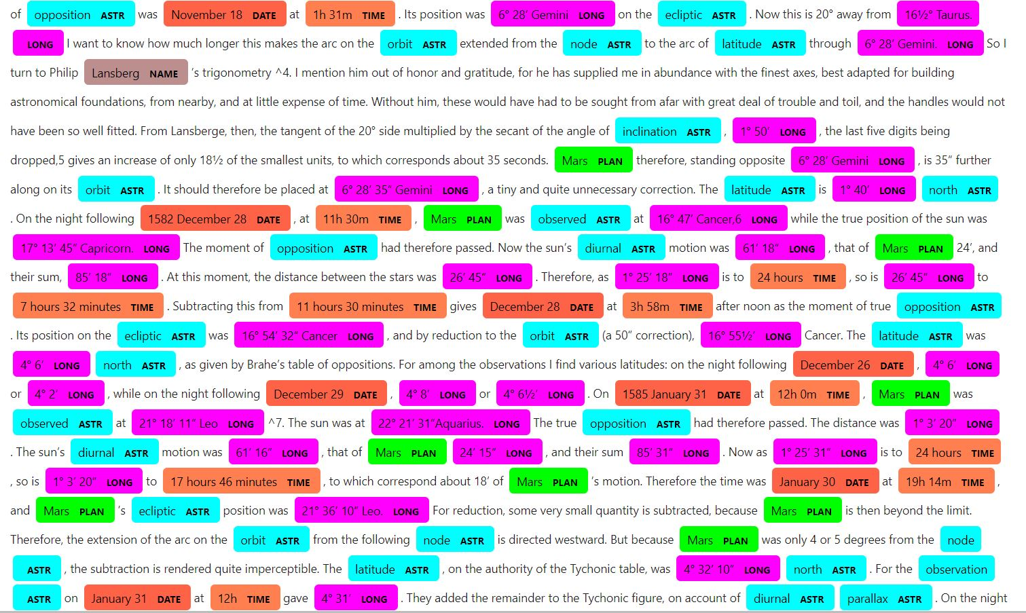

Slide 4
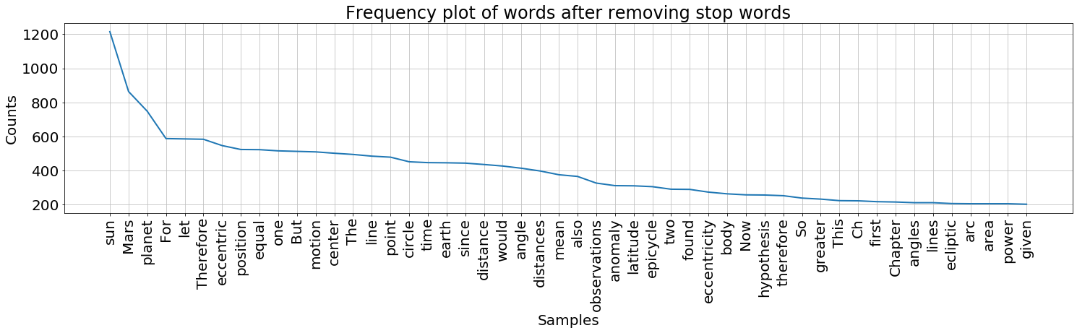

Slide 6
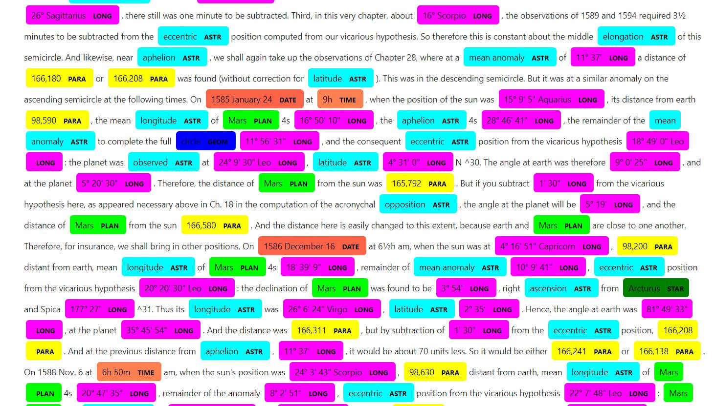

Slide 7


Slide 8
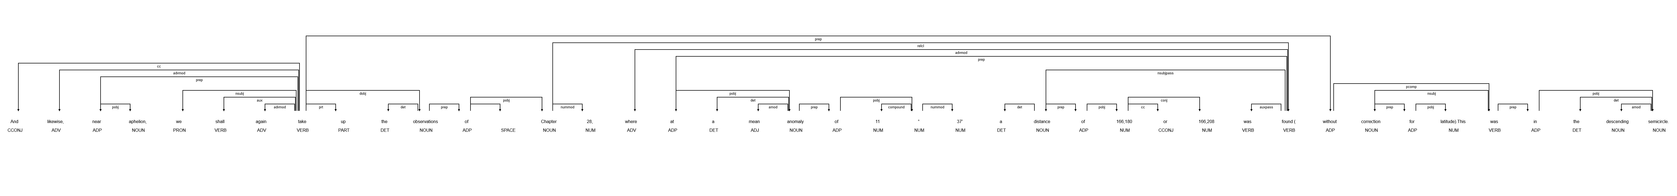
Dependency parsing graph

Slide 9
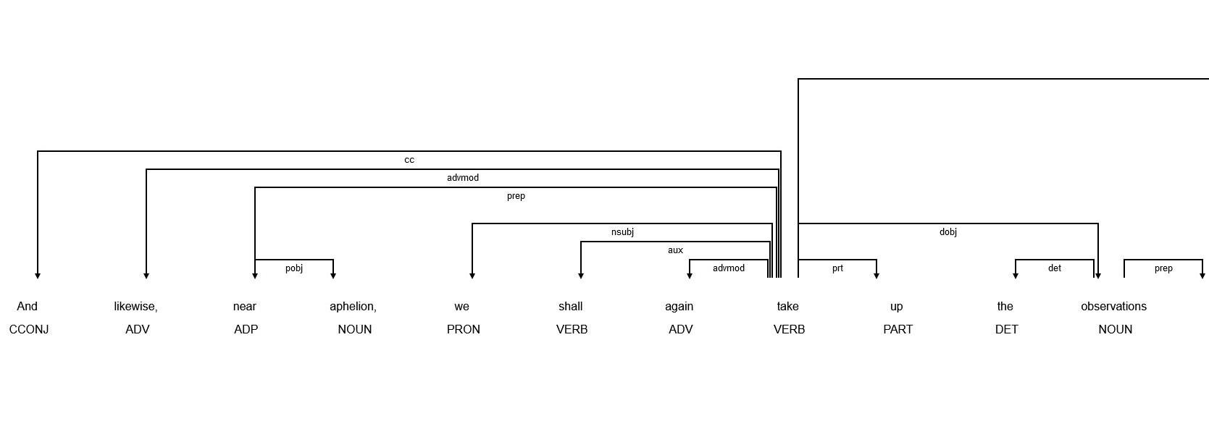
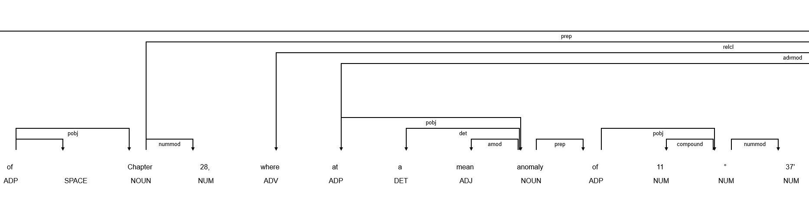
Dependency parsing graph part-01

Slide 10
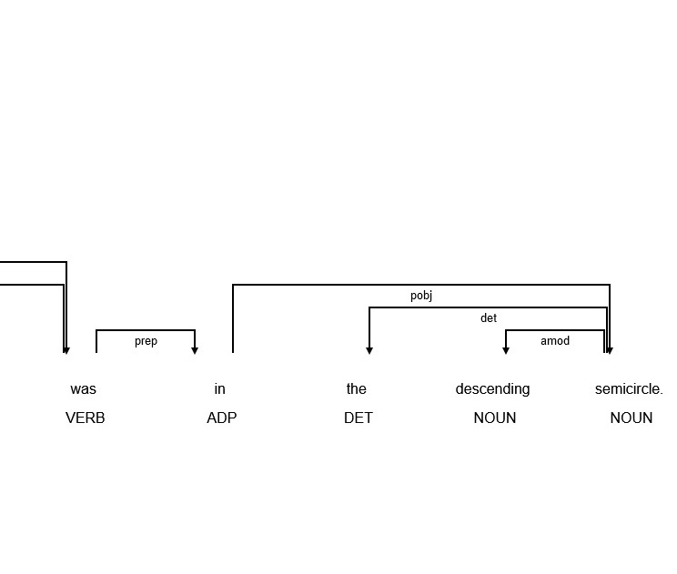
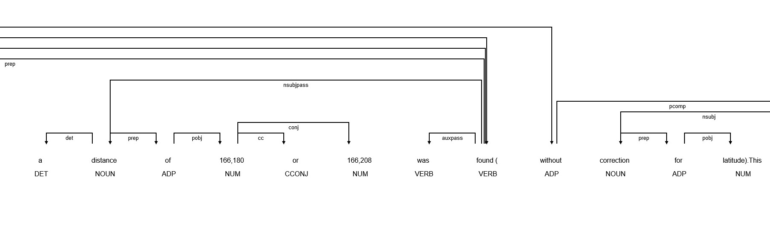
Dependency parsing graph part 02

Slide 11
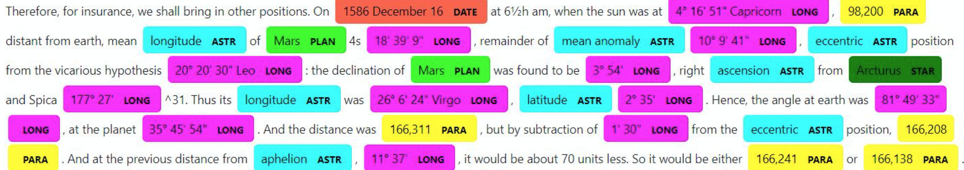

Slide 12
Machine learning challenge
NLTK modeling with Spacy
Text features for machine learning
Content representation in graph structures
Scientific models
Empirical data
Measuring procedures
Inferential relationships
Propositional attitudes
Methodological approaches
Causal reasoning
Model construction and assessment

